Slide 1
Generative Adversarial Networks
Thomas Wang, Penny Brant

Slide 2
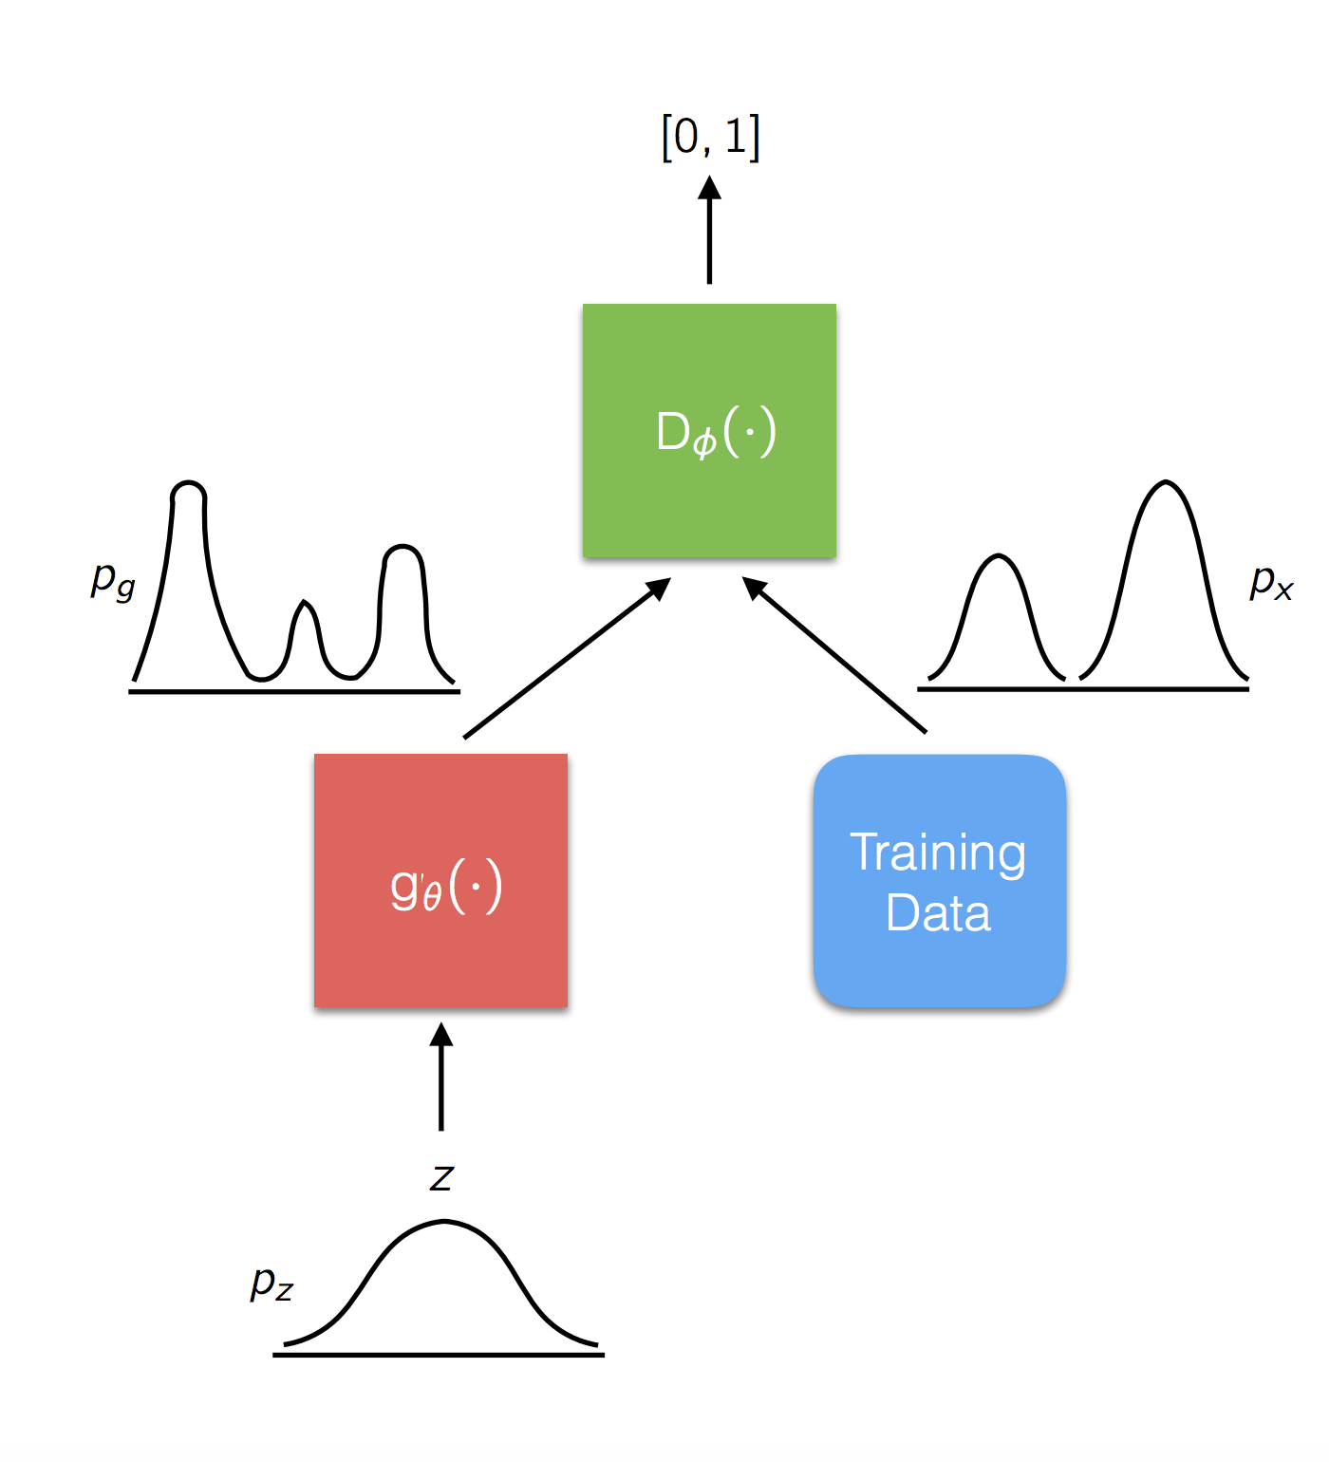
What Is A GAN?
Class of unsupervised machine learning algorithm.
Two neural networks compete in a zero-sum game framework.
Discriminator D estimates the probability of a given sample coming from he real dataset, P_{data}(x)
Generator G, which outputs synthetic samples given a noise variable input z.

Slide 3
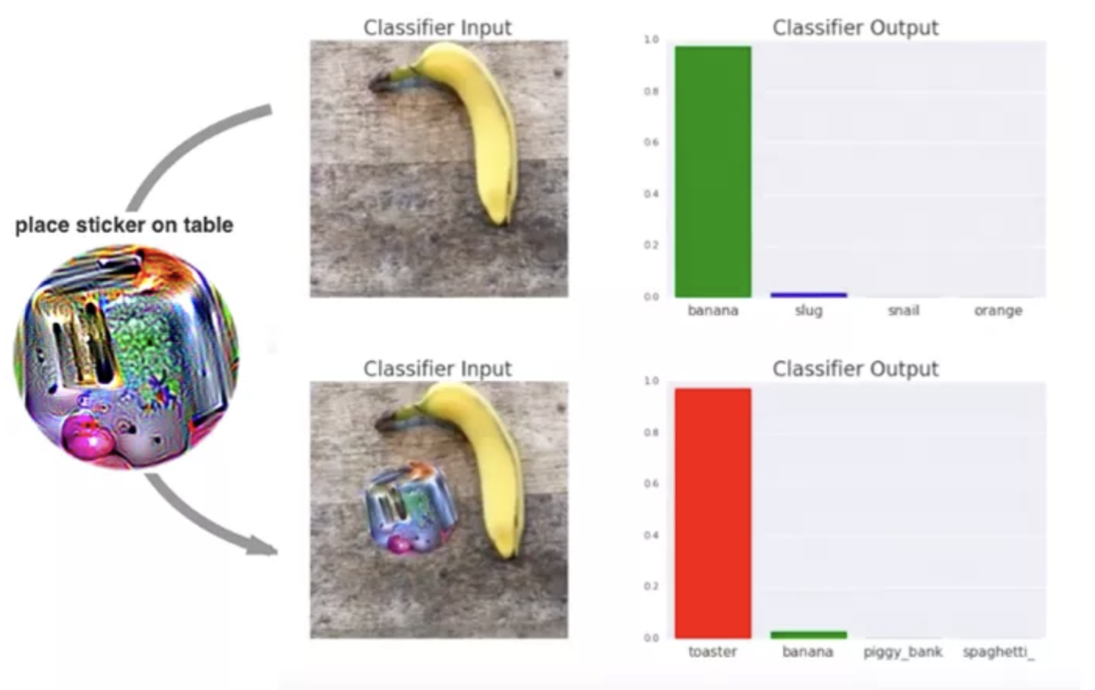
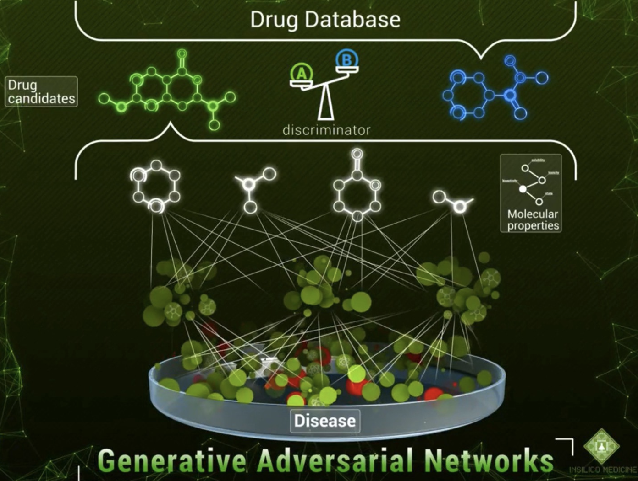
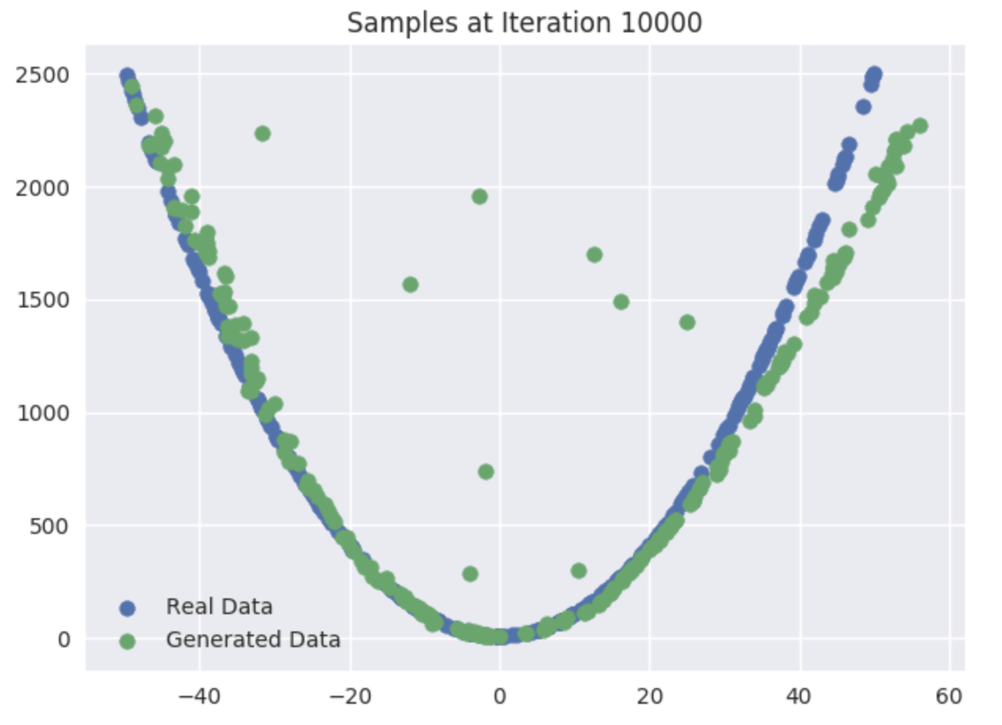
Practical Applications of GAN
Based on existing noise data, a GAN network is able to generate data points that fits into the manifold

Slide 4
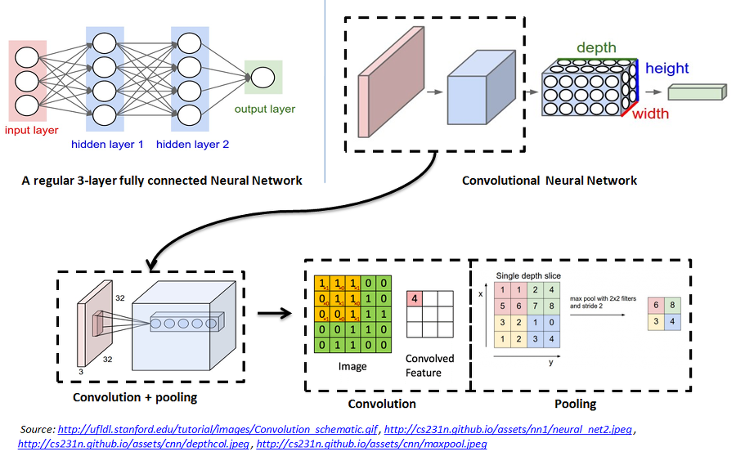

Convolutional Neural Network
Commonly used for machine vision
Based on organization of animal visual cortex
Translation Invariance

Slide 5
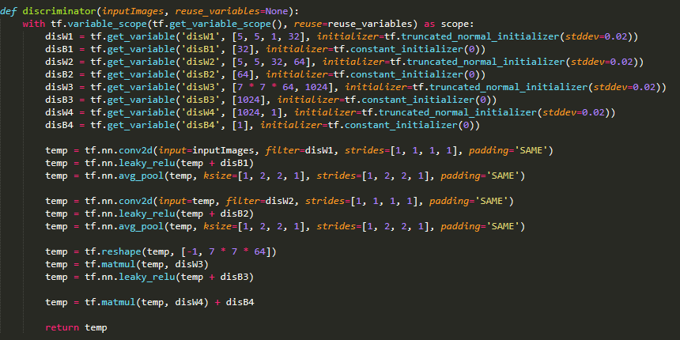
Discriminator
2 Convolutional Layers with 32, 64 filters
2 Dense Layers
Leaky ReLu Activation

Slide 6
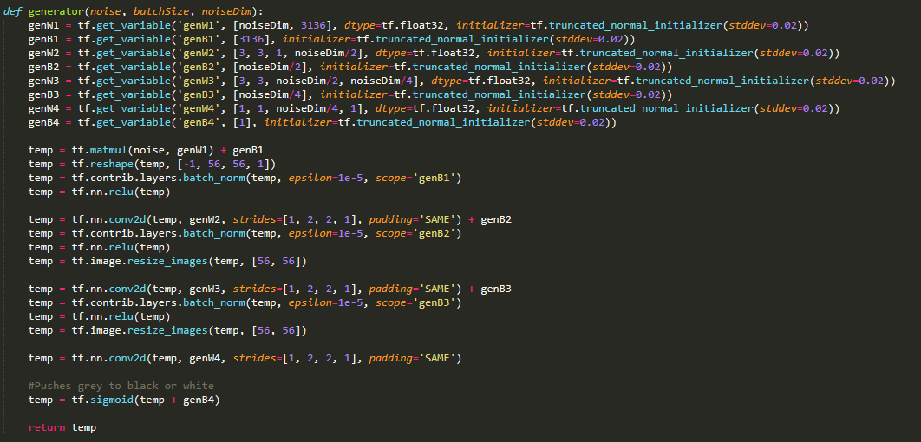
Generator

Slide 7
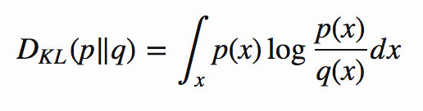
KL(Kullback-Leibler) Divergence
KL achieves the minimum zeros when p(x) == q(x) everywhere
KL divergence is asymmetric: In cases where p(x) is close to zero, but q(x) is significantly non-zero, q’ effect is disregarded.

Slide 8
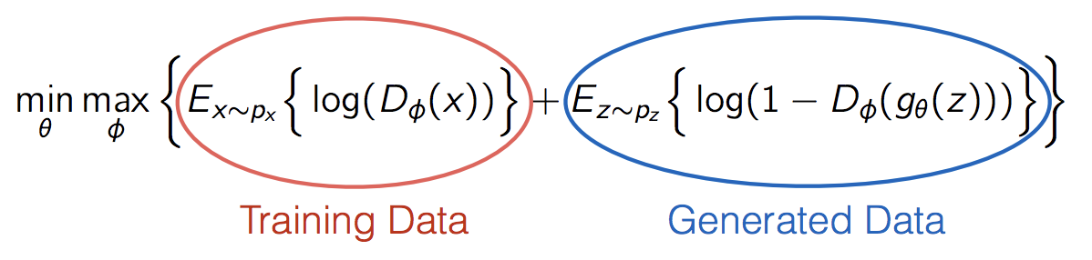
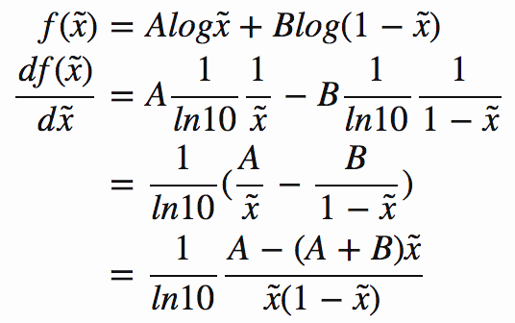
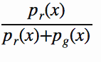
Min Max Game
Essentially, the generator tries to minimize this value, while the discriminator tries to maximize the loss-function.
If we set x = D(x), A = p_{data}(x) and B = P_{g}(x), we get that:
D*(x) = x* = A/(A+B), which is equal to
Notes:
We know that max[V(G,D)] = max[∫_{x} p_{data}(x) log(D(x)) dx+∫_{z}p_{Z}(z)log(1−D(g(z)))dz] occurs when d p_{data}(x) log(D(x)) + p_{Z}(z)log(1−D(g(z)))dz/ dx = 0, the optimal discriminator D*(x) is when D*_{g}(x) = p_{data}(x)/ (p_{data}(x) + p_{g}(x)) and the minimum is -2log(2)

Slide 9
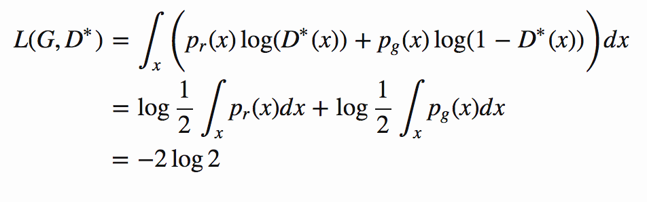
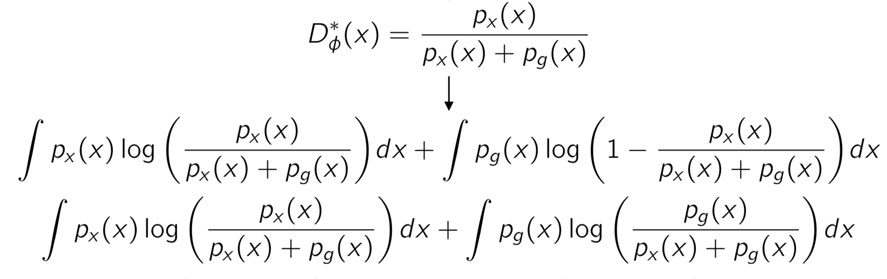
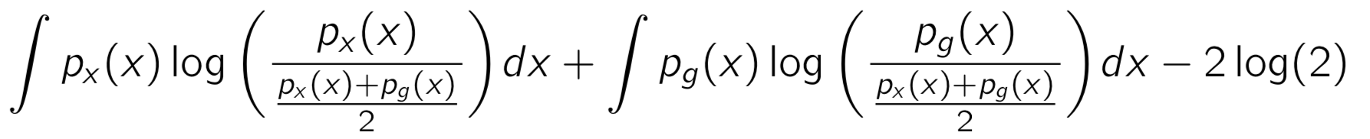
Where’s the global optimal?
When D and D are at their respective optimal values, we know that p_{g} = p_{r} and D*(x) = ½. Therefore, the loss function becomes:

Slide 10
Issues with GAN
Hard to achieve Nash Equilibrium
Low dimensional supports
Vanishing gradients
Model collapse

Slide 11
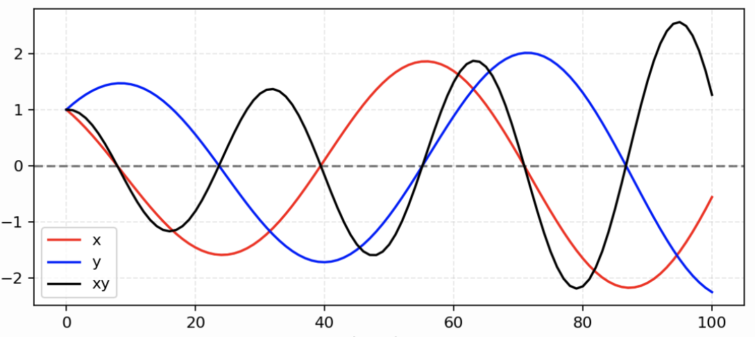
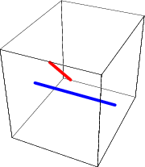
Nash Equilibrium Low Dimension Supports
In the example, D(x) tries to minimize xy while G(x) tries to minimize -xy.
Images are bound by low manifolds, which on the most part are disjointed.
We can clearly see that as time goes on the instability gets worse.
There will always be an optimal discriminator.

Slide 12
Unstable Gradient
From the low dimension supports, we are guaranteed with an optimal discriminator where :
D(x) = 1 for x ∈ data and D(x) =0 for x ∈ generated data
Therefore, the loss function
If D behaves badly:
the generator does not have accurate feedback and the loss function cannot represent the reality
If Does a great job:
gradient and loss function drops near zero and GAN doesn’t lear.
Falls into zero and there is no gradient.

Slide 13
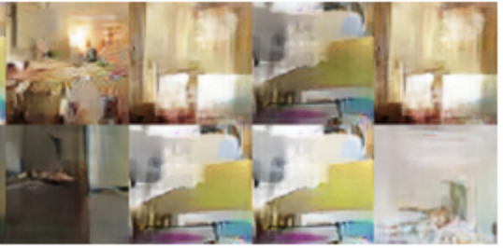
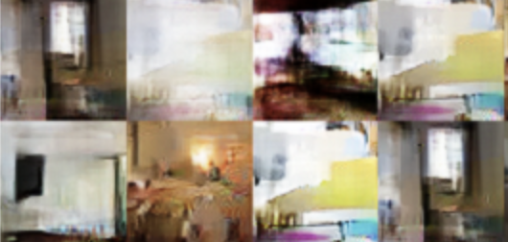
Mode Collapse
Generator generates a limited diversity fo samples, regardless of the input.
Generator gradients are identical
Same maximum point x*

Slide 14
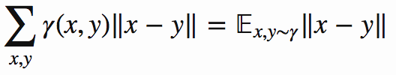
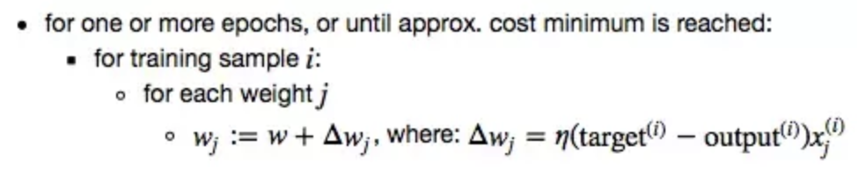
Wasserstein Distance
Wasserstein Distance/ Earth Mover’s distance
measure of the distance between two probability distributions.
Wasserstein Distance Cost Function:

Slide 15
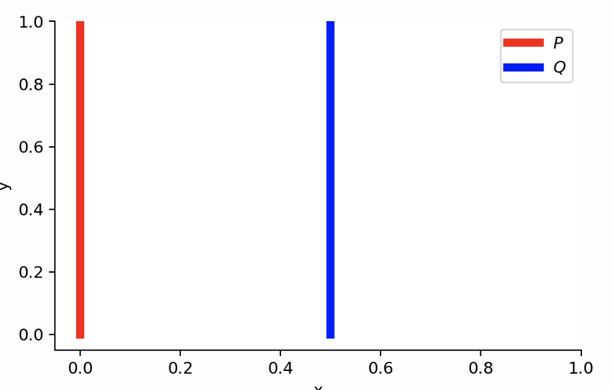
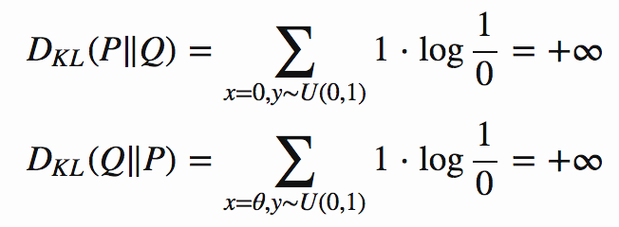
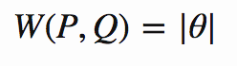
WGAN
Example, when p distributions are disjointed manifolds only Wasserstein metric provides smooth measure.

Slide 16
Optimization

Slide 17
SGD with Momentum

Slide 18
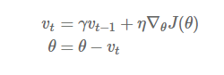
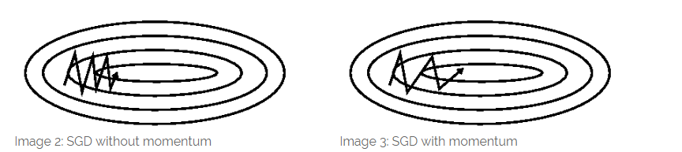
SGD has trouble navigating ravines, areas where the surface slopes much steeper in one dimension than in another
Momentum helps accelerate SGD in the relevant direction and dampens oscillations

Slide 19
RMSprop

Slide 20
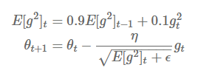
adapts the learning rate to the parameters, performing larger updates for infrequent and smaller updates for frequent parameters
Instead of accumulating all past squared gradients, RMSprop restricts the window of accumulated past gradients to some fixed size w using exponential decay

Slide 21
ADAM OPTIMIZER
Adaptive moment estimation

Slide 22
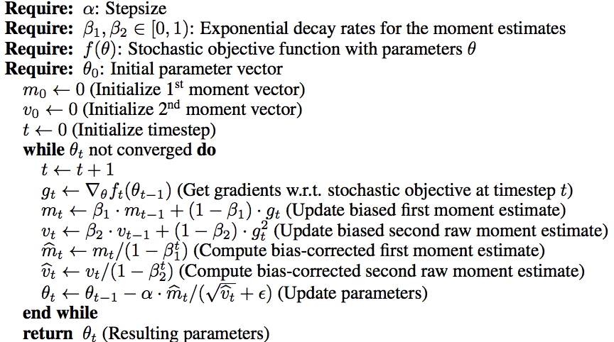
Computes adaptive learning rates for each parameter.
Calculates exponential moving average of the gradient and the squared gradient.
“Intuitively, ADAM basically behaves like momentum, but with a very fat ball and a lot of friction.”
Therefore, it prefers flat minima in error surface.
Adapting specific parameter based learning rates based on average first moment(the means)

Slide 23
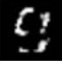
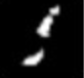
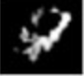
Results
Below are some resulting images from our GAN that are falsely classified as real data by our discriminator.

Slide 24
How To Run
Install Python3: https://www.python.org/downloads/
Install numpy: https://scipy.org/install.html
Install tensorflow: https://www.tensorflow.org/install/
Paste Code into .py file from: https://codeshare.io/2jOk6K
Run as Python 3 Code

